Slide 1
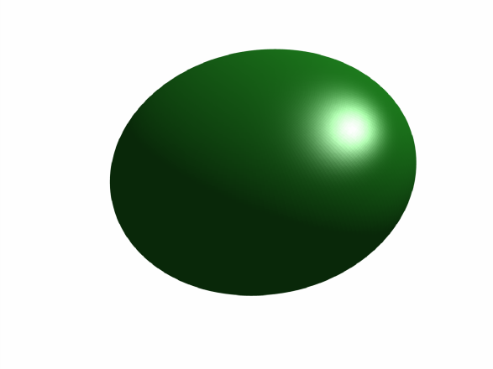
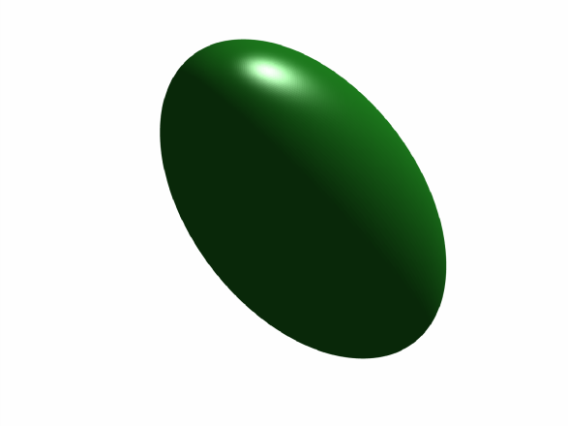
Analytical Expressions for Deformation from an Arbitrarily Oriented Spheroid in a Half-Space
Peter F. Cervelli
USGS Volcano Science Center
December 12, 2013
U.S. Department of the Interior
U.S. Geological Survey

Slide 2
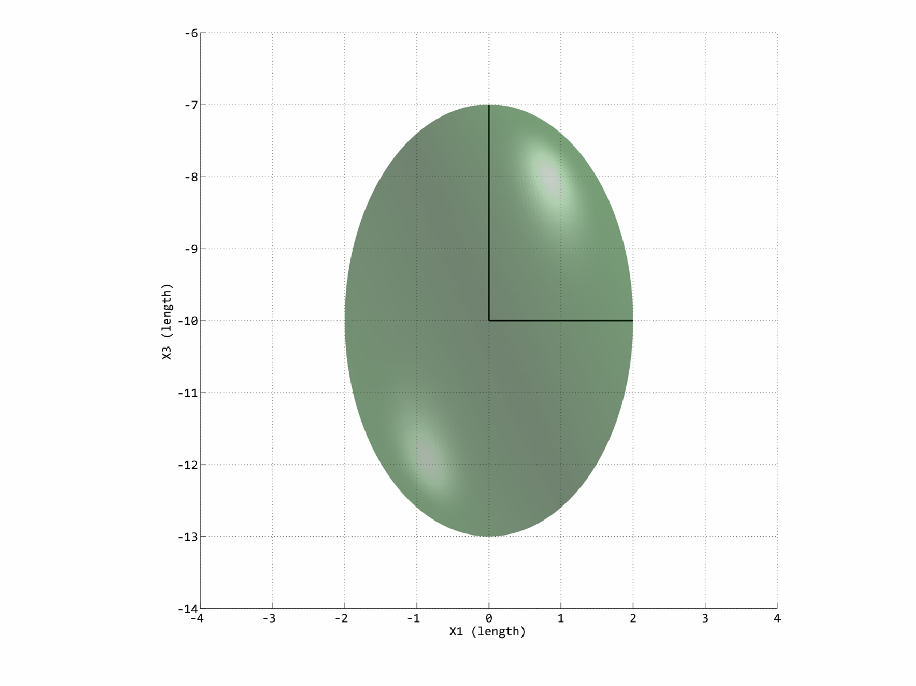
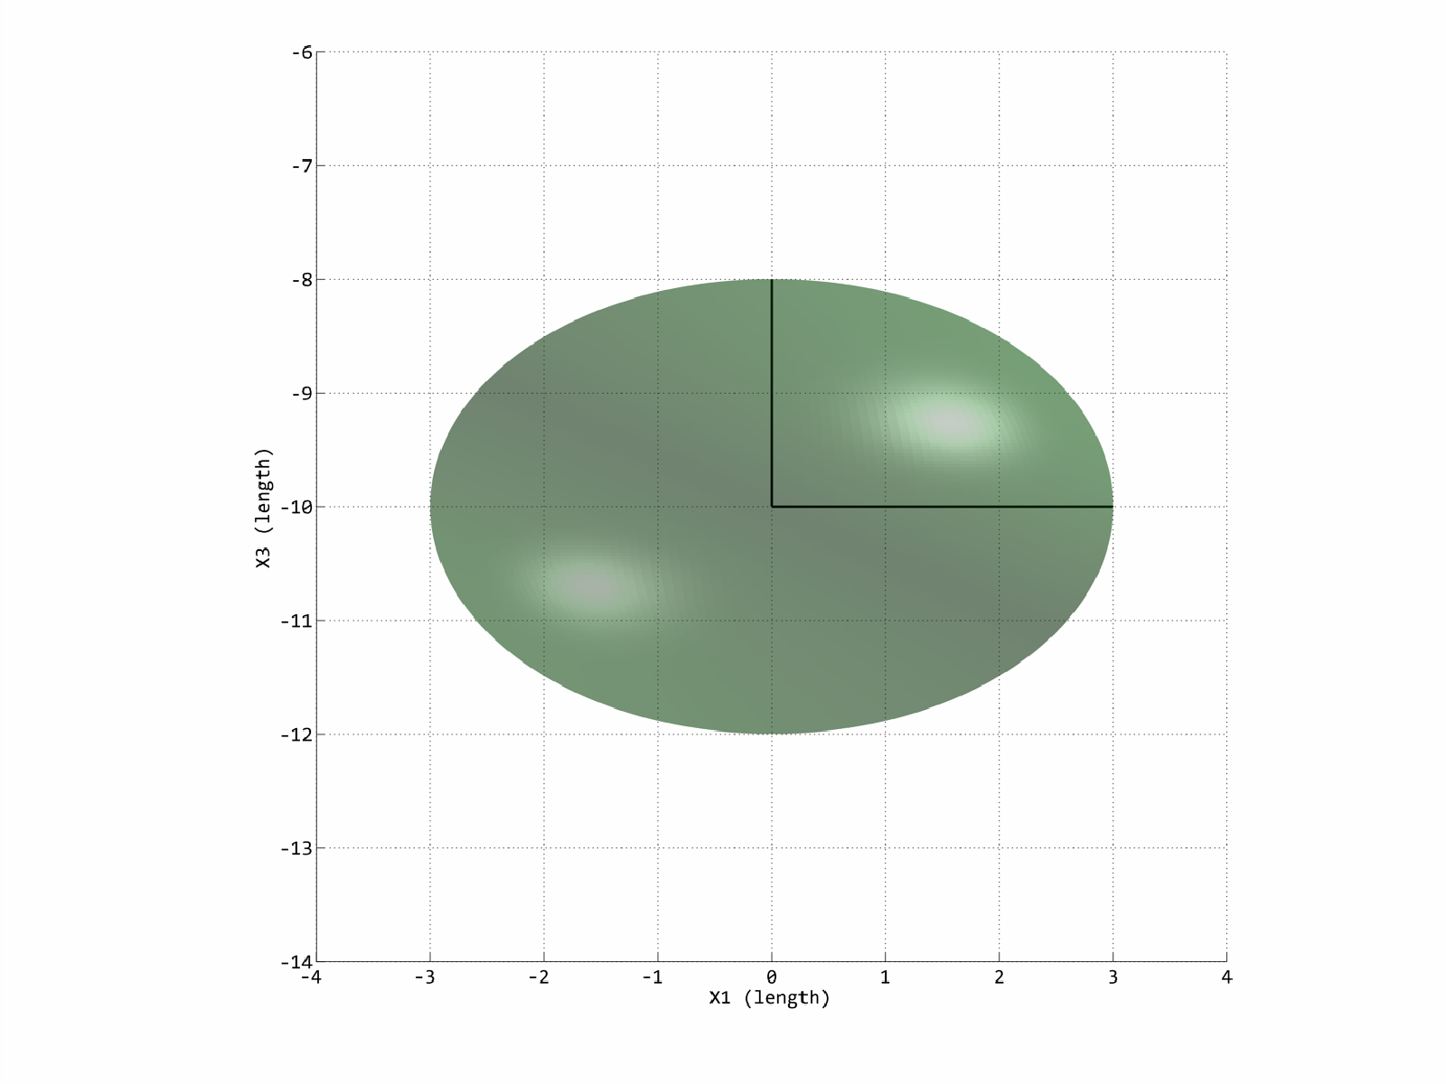
A spheroid is an ellipsoid having two axes (b) of equal length.
Prolate
Oblate
a
a
b
b
a > b
b < a

Slide 3
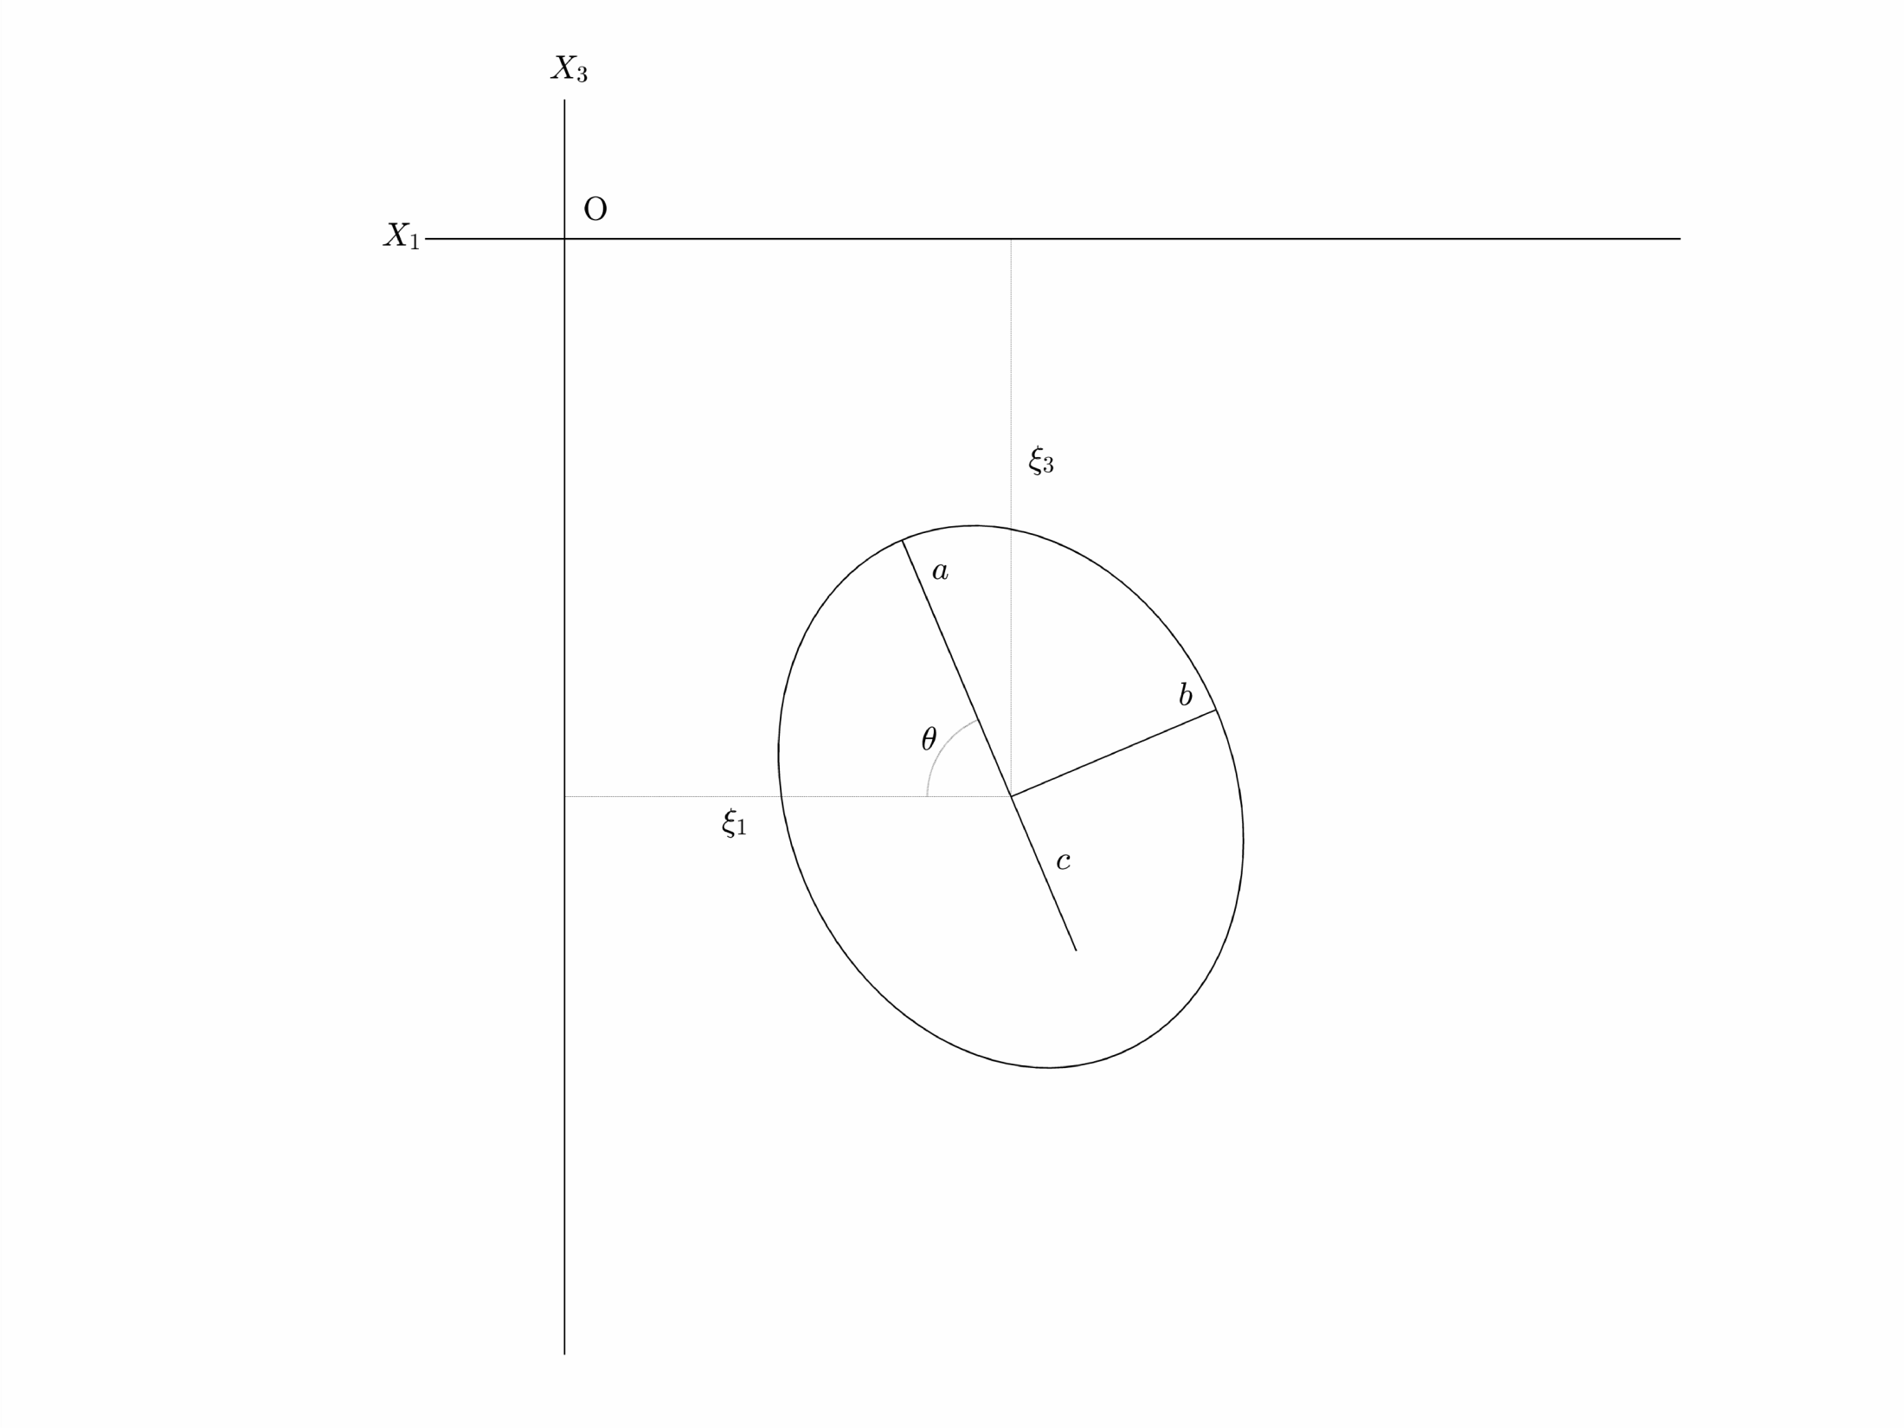
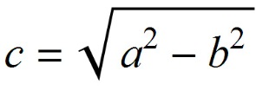
Spheroid
Geometry
For an oblate spheroid, c is a complex number

Slide 4
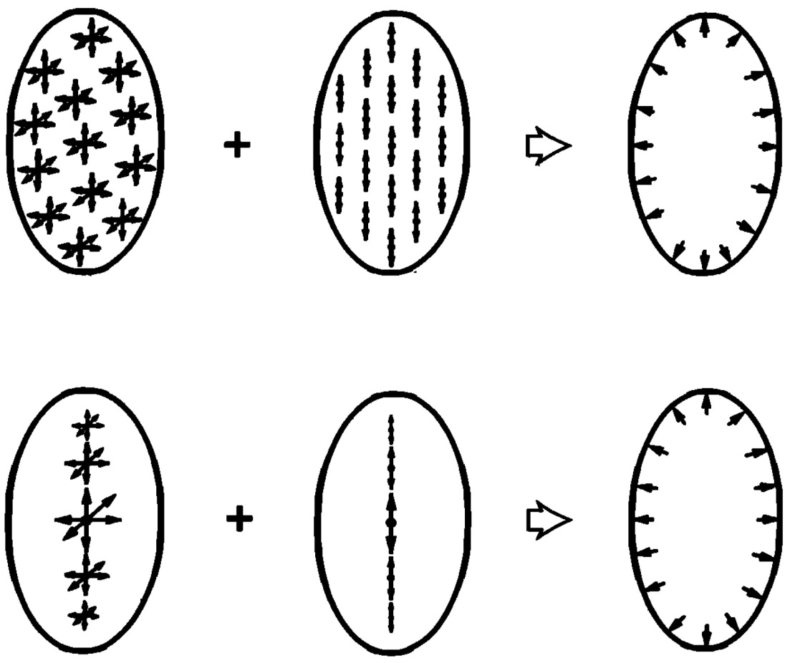
Satisfying the Uniform Internal Pressure Boundary Condition
Eshelby, 1957
Uniform distribution, constant strength
Yang, 1988
Line distribution, variable strength
Strength varies quadratically
Centers
of
Dilatation
Double
Forces
Uniform
Internal
Pressure

Slide 5
Volterra’s Equation for Displacement as Expressed by Yang et al., 1988
Center
of
Dilatation
Horizontal
Double
Force
Vertical
Double
Force
Mixed
Double
Forces
=
Point Force Green’s functions
=
Strength function for Center of Dilatation
=
Strength function for Double Forces
=
Spheroid Dip

Slide 6
Volterra’s Equation for Displacement as Expressed by Yang et al., 1988
Center
of
Dilatation
Horizontal
Double
Force
Vertical
Double
Force
Mixed
Double
Forces
=
Point Force Green’s functions
=
α₁ξ² + α₂ξ + α₃
=
β₁ξ² + β₂ξ + β₃
=
Spheroid Dip

Slide 7
Volterra’s Equation for Displacement as Expressed by Yang et al., 1988
Center
of
Dilatation
Horizontal
Double
Force
Vertical
Double
Force
Mixed
Double
Forces
=
Point Force Green’s functions
a₁− b₁ (ξ² + c²)
=
a₁ and b₁ are the unknown coefficients that define the strength functions
=
a₁ν (ξ² + c²)/b²
=
Spheroid Dip

Slide 8
Methodology of Solution
Solve integral using full space Green’s functions, assuming θ = 90°.
Determine parameters (a₁ and b₁) defining strength functions by using uniform pressure boundary condition.
Solve integral using half space Green’s functions and combine with strength function parameters found above.

Slide 9
1. Solve Integral with Full Space Green’s Functions
θ = 90°
Wolfram Research, Inc., Mathematica, Version 9.0, Champaign, IL (2012).

Slide 10
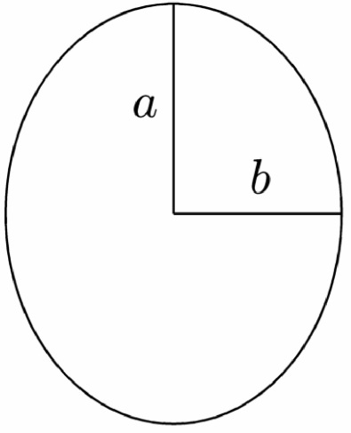
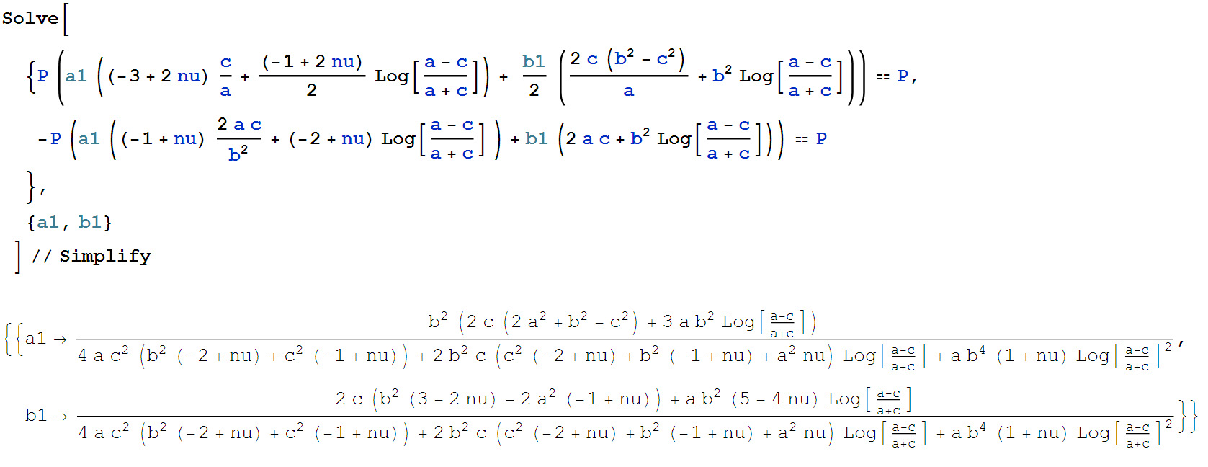
2. Determine strength function parameters
Pressure at x₁ = 0 and x₃ = a
Pressure at x₁ = b and x₃ = 0
Values for a₁ and b₁ depend only on geometry of spheroid and elastic constants

Slide 11
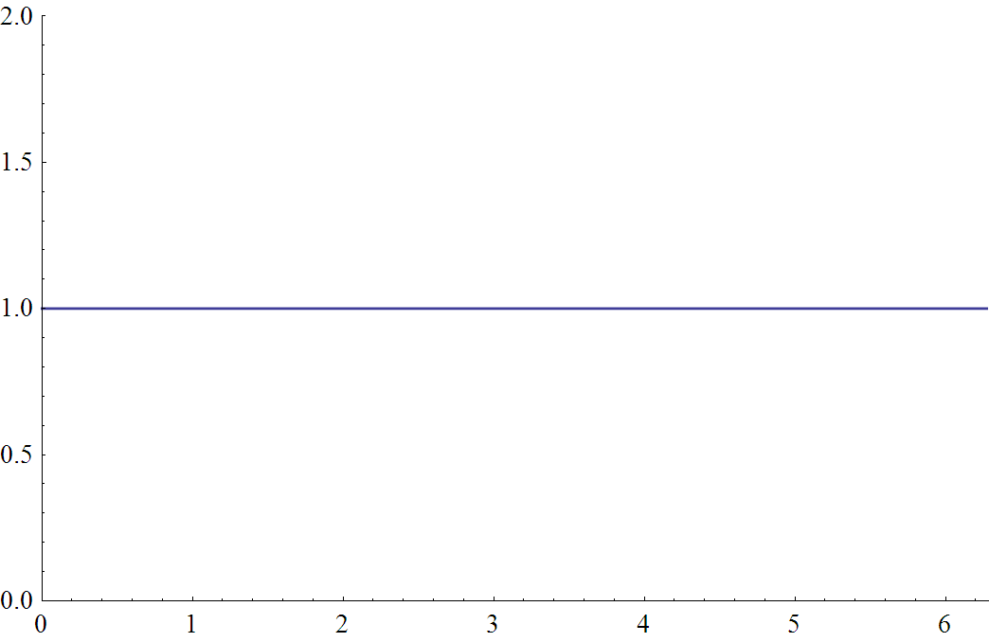
2. (continued) Check Boundary Condition
Plugging in the values for a₁ and b₁ derived above, we can test the uniform pressure boundary condition
P(φ) = n^{T} S n
Stress tensor as function of φ
Surface normal vector as function of φ
P(φ)
φ

Slide 12
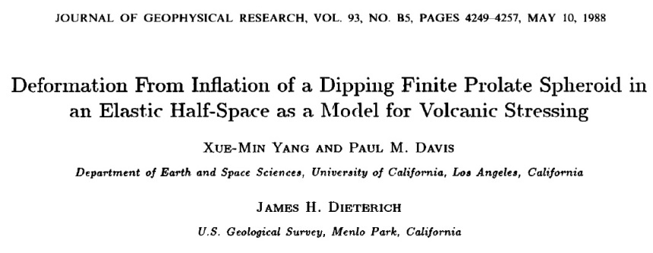
3. Solve Integral with Half Space Green’s Functions
Although Yang’s 1988 paper has typos, the presented solution is otherwise correct.
My work extends Yang’s by providing:
Displacement derivatives, strains, and stresses
Properly handled limiting cases
Proof that Yang’s method works for oblate spheroids
A very good approximation to the volume/pressure relationship
Error-free code, validated by Mathematica

Slide 13
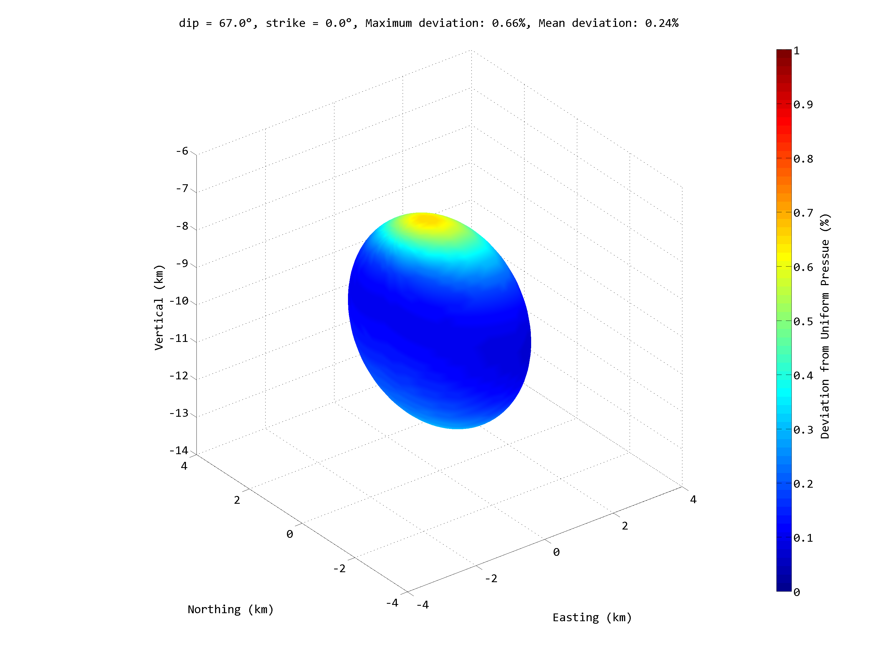
How Well is the Uniform Pressure Boundary Condition Satisfied?
Spheroid Parameters
a = 3000 m
b = 2000 m
Depth = 10000 m
P/μ = 1

Slide 14
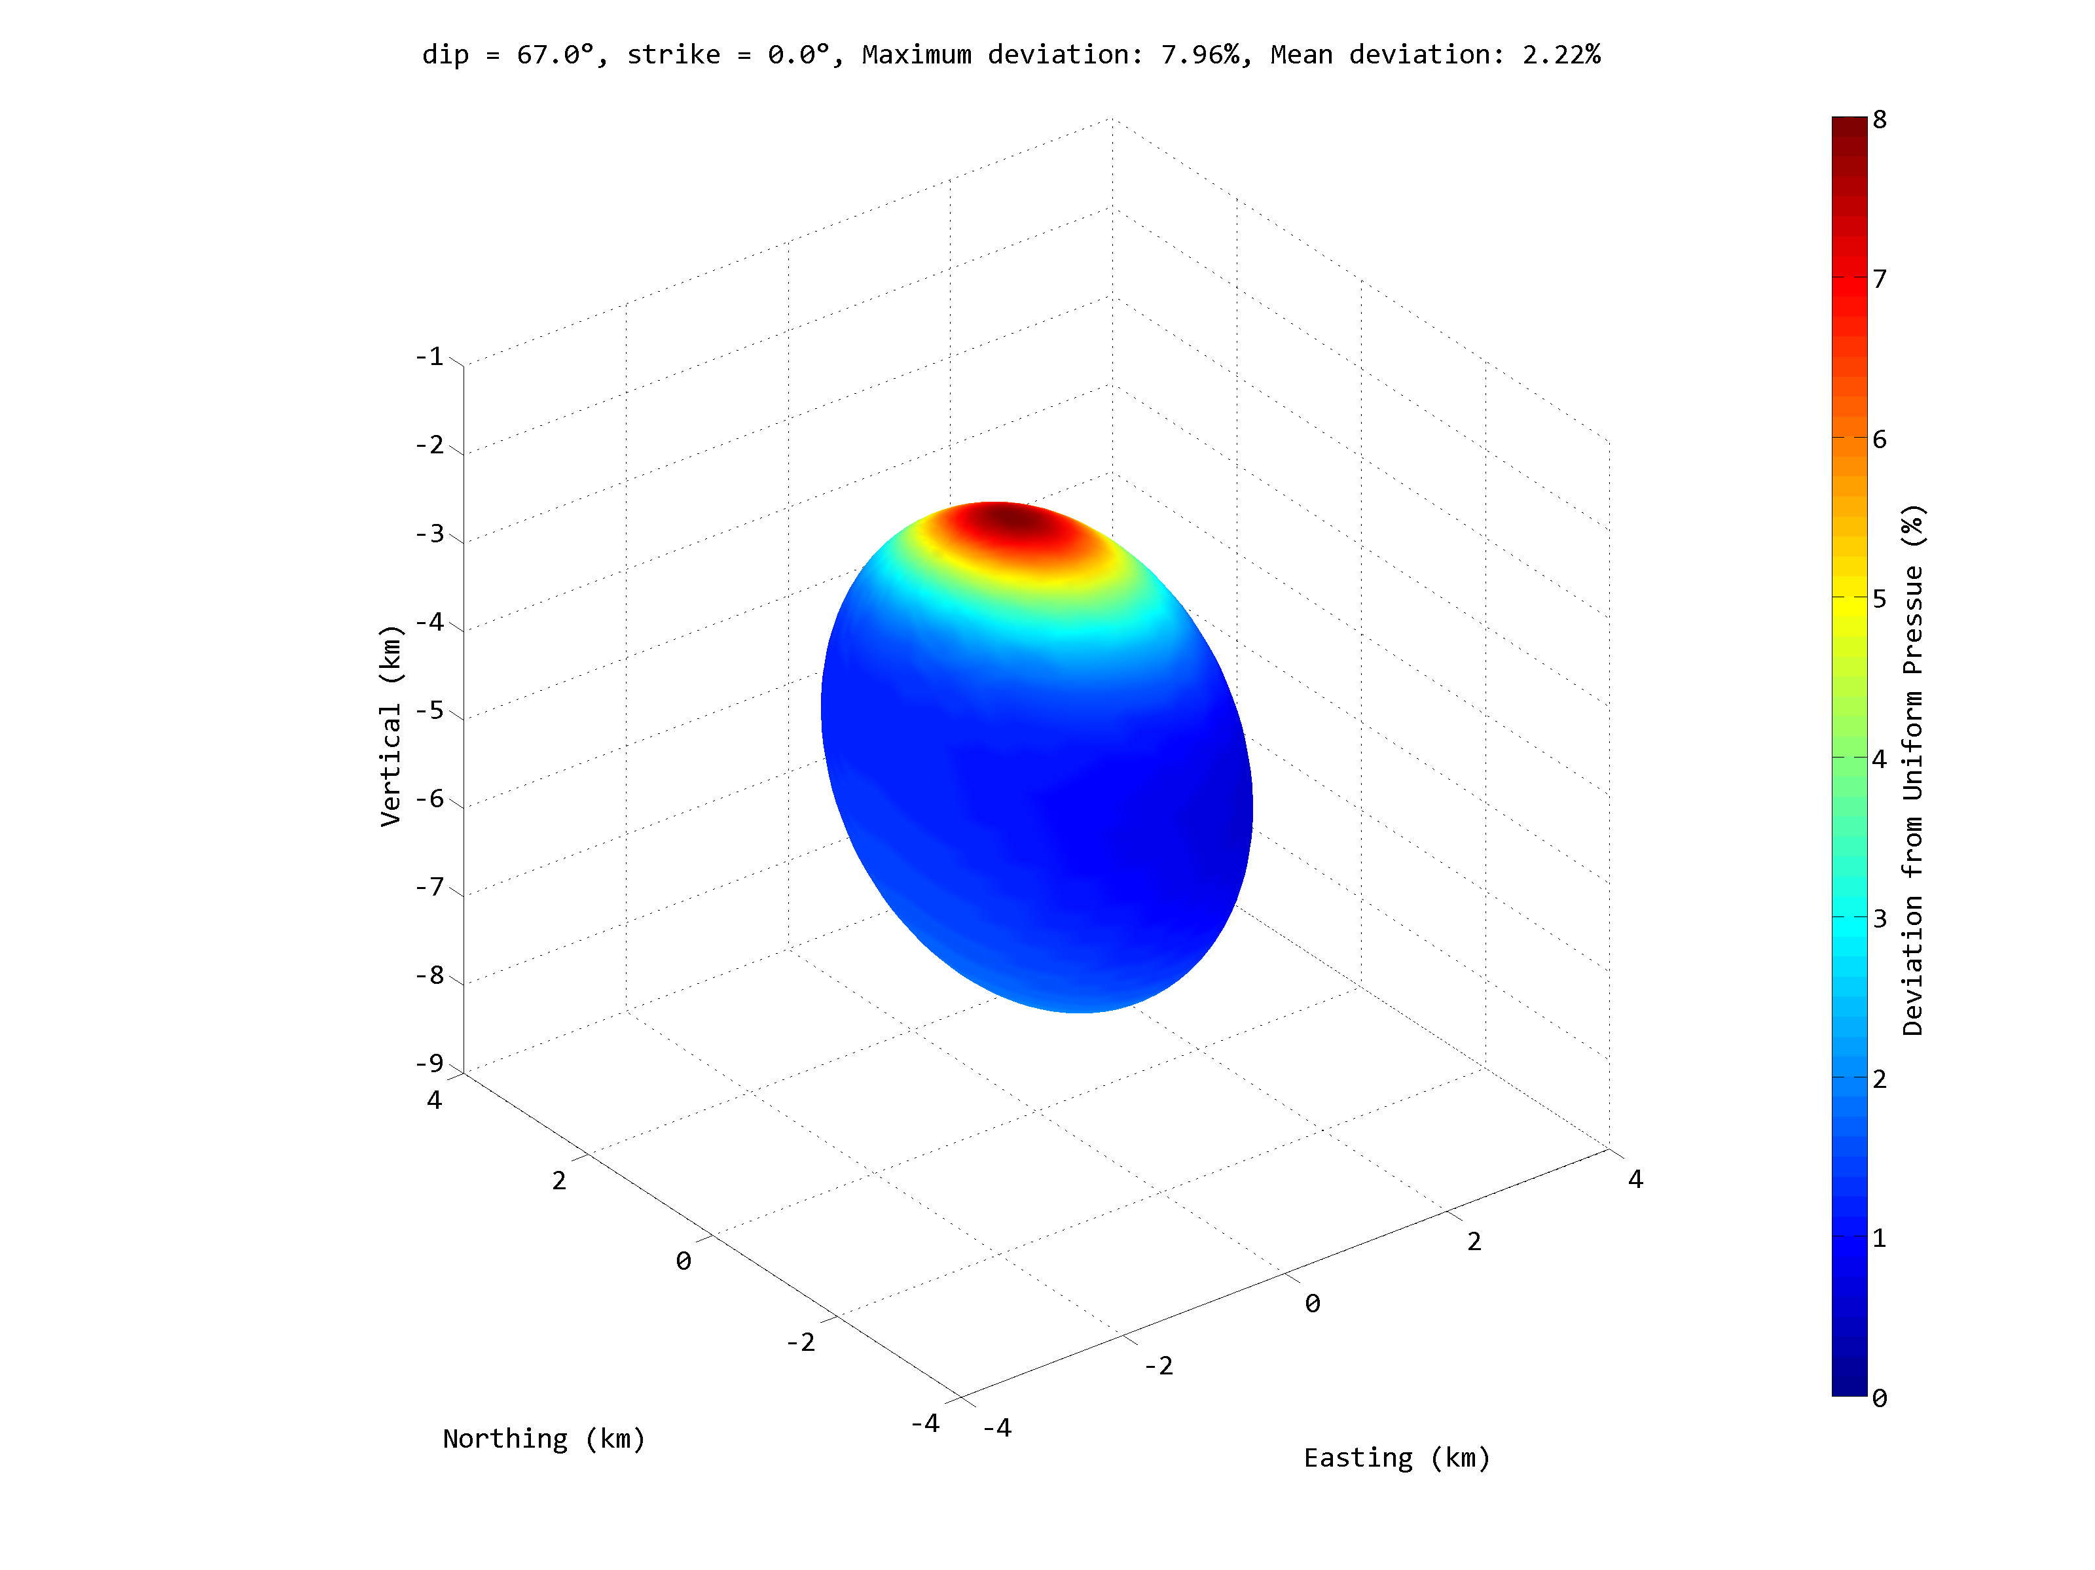
How Well is the Uniform Pressure Boundary Condition Satisfied?
Spheroid Parameters
a = 3000 m
b = 2000 m
Depth = 5000 m
P/μ = 1
As depth decreases the departure from uniformity increases.

Slide 15
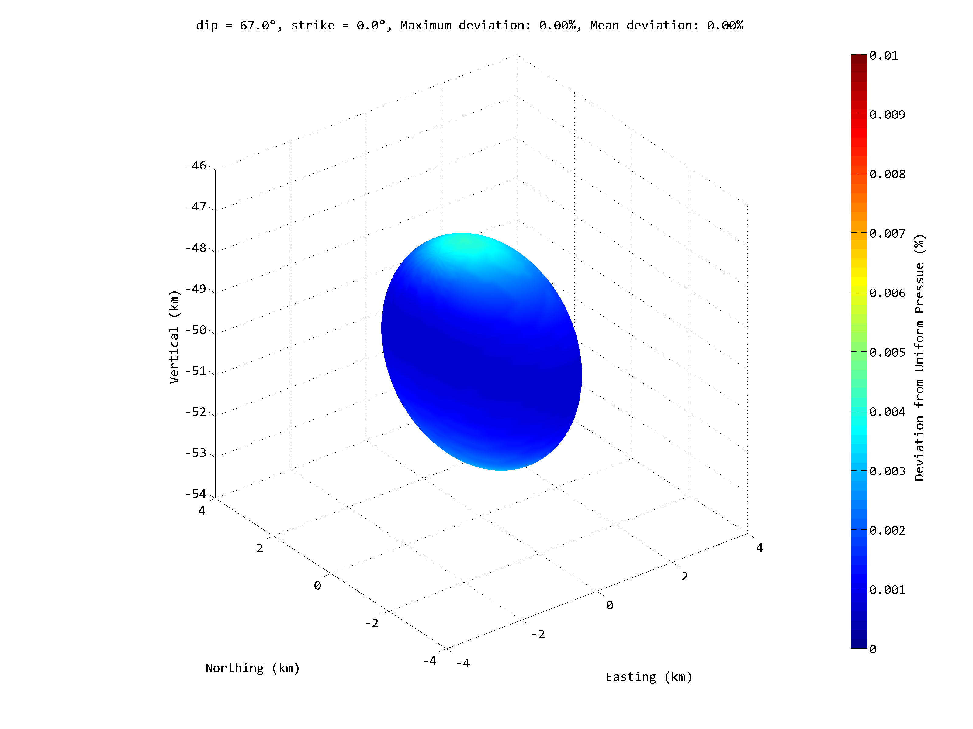
How Well is the Uniform Pressure Boundary Condition Satisfied?
Spheroid Parameters
a = 3000 m
b = 2000 m
Depth = 50000 m
P/μ = 1
As depth goes to infinity the deviation from uniformity goes to zero.

Slide 16
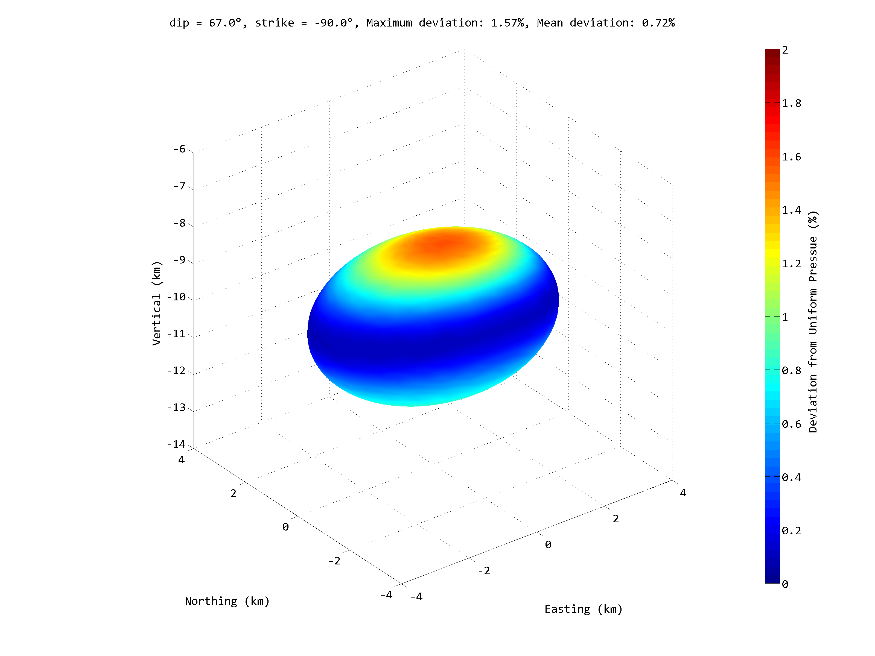
The Oblate Spheroid
Spheroid Parameters
a = 2000 m
b = 3000 m
Depth = 10000 m
P/μ = 1
Why does this work? When a < b, then c becomes complex!

Slide 17
When c is Complex, the Resultant Displacements are Still Real
Consider the full space version of Volterra’s equation:
Re-write the equation for the oblate case:
We can then push the i into the variable of integration, ξ, and expand the result.

Slide 18
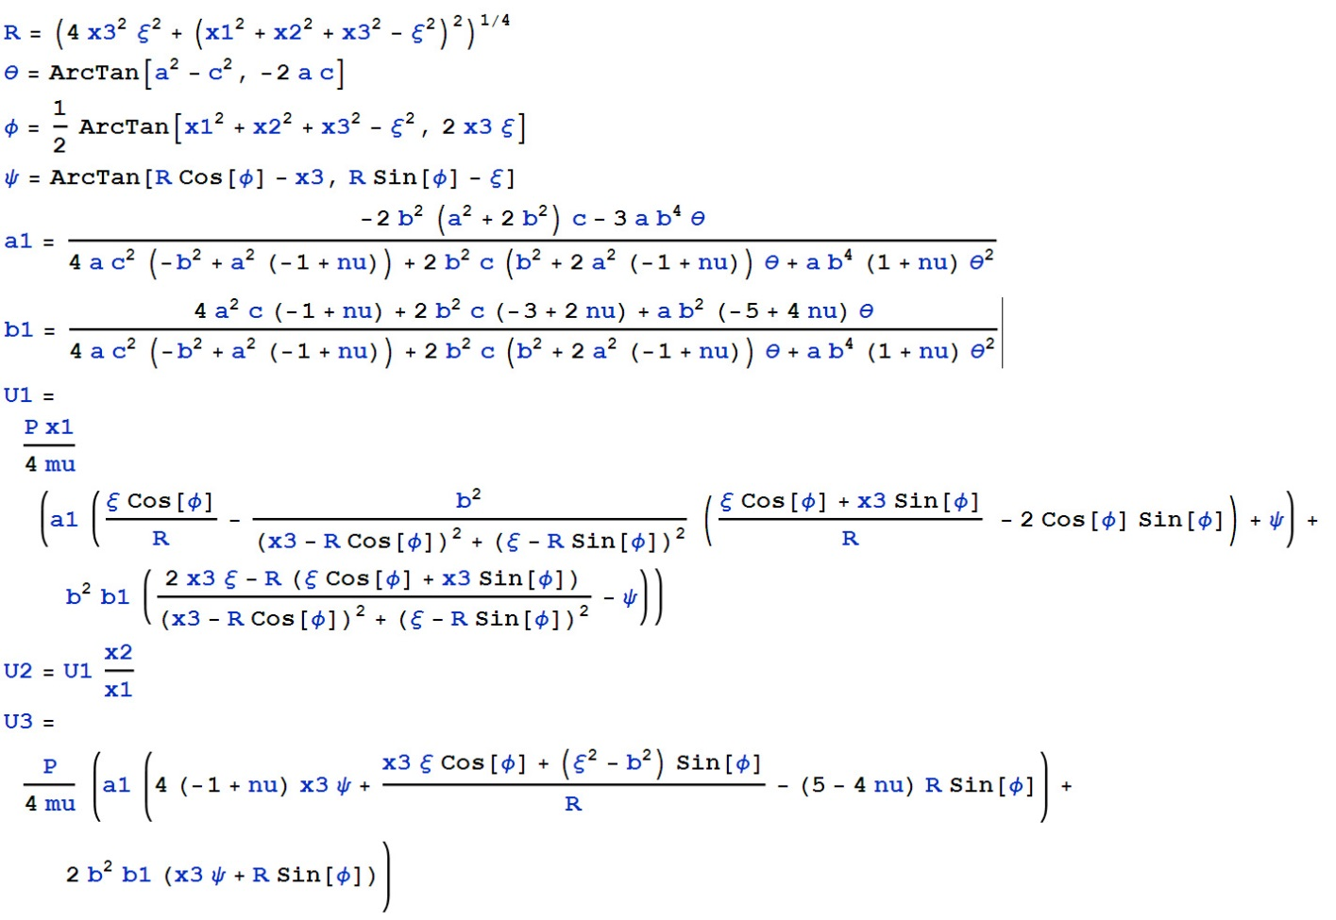
Oblate Spheroid Deformation in a Full Space
Real Expressions
But, from a practical point of view, re-writing the equations is not necessary, provided your programming language supports complex numbers – the imaginary part of the output always cancels to zero ( ± rounding errors).

Slide 19
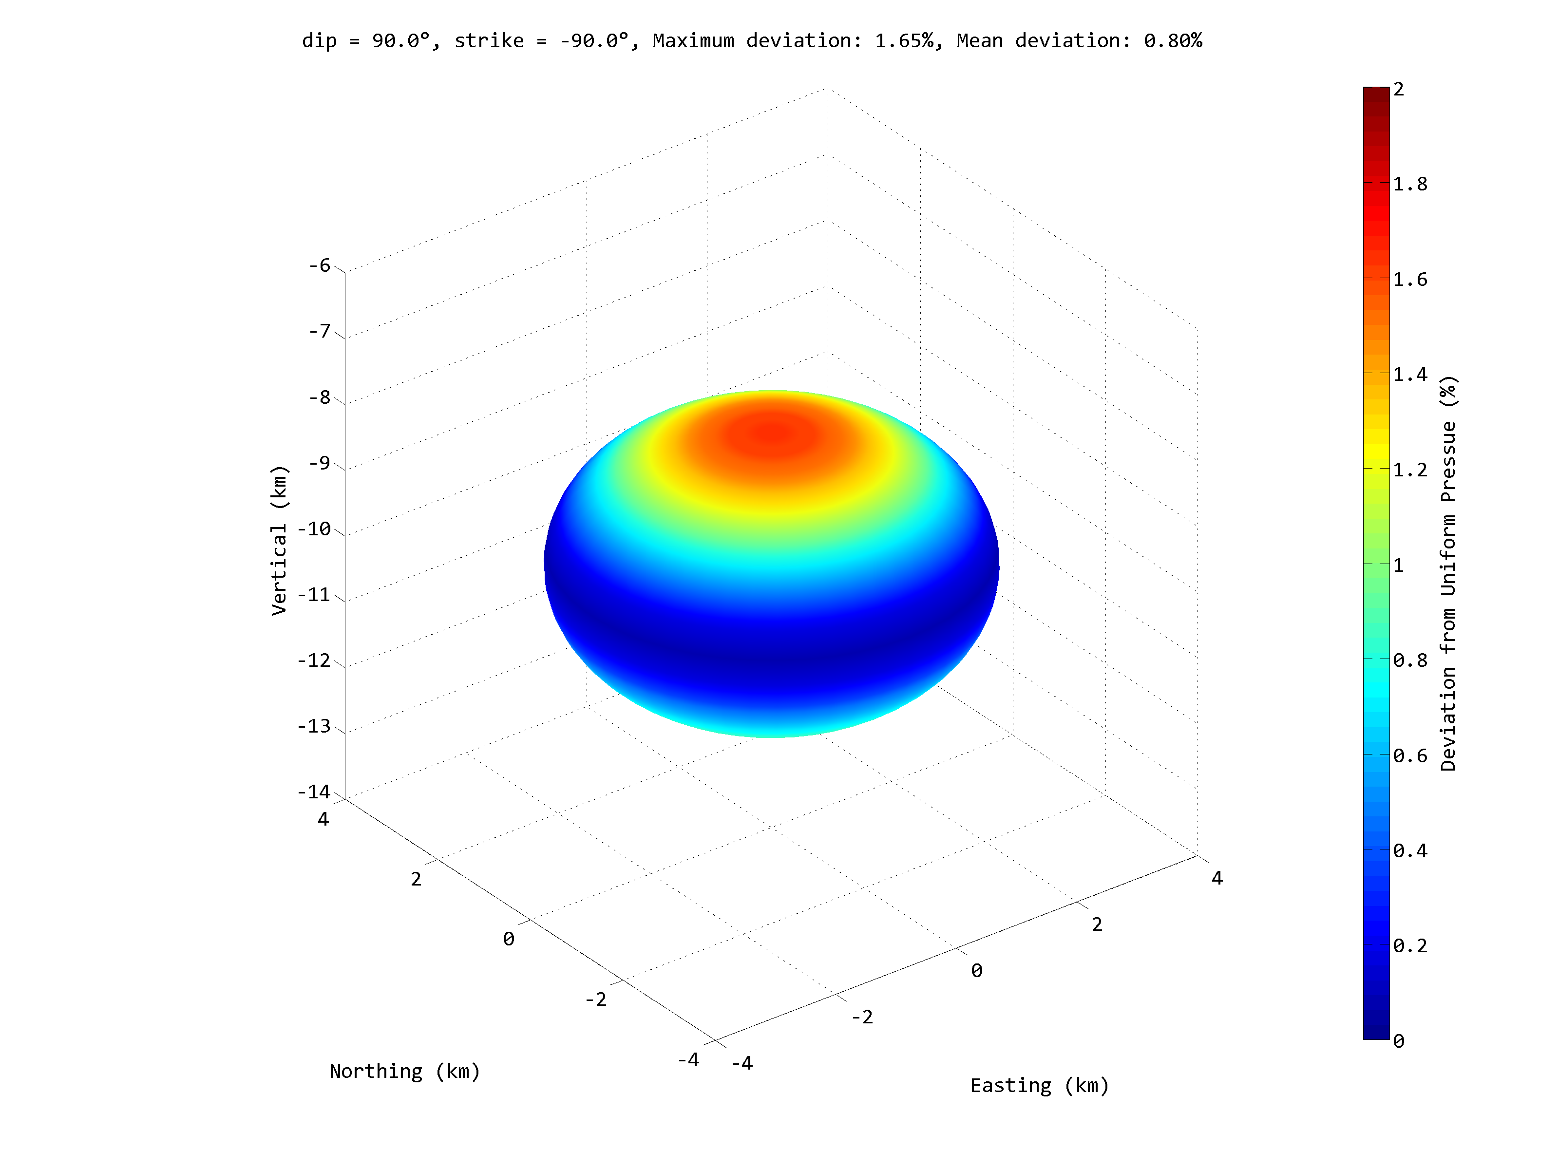
The Oblate Spheroid as a Goes to Zero
Spheroid Parameters
a = 2000 m
b = 3000 m
Depth = 10000 m
P/μ = 1

Slide 20
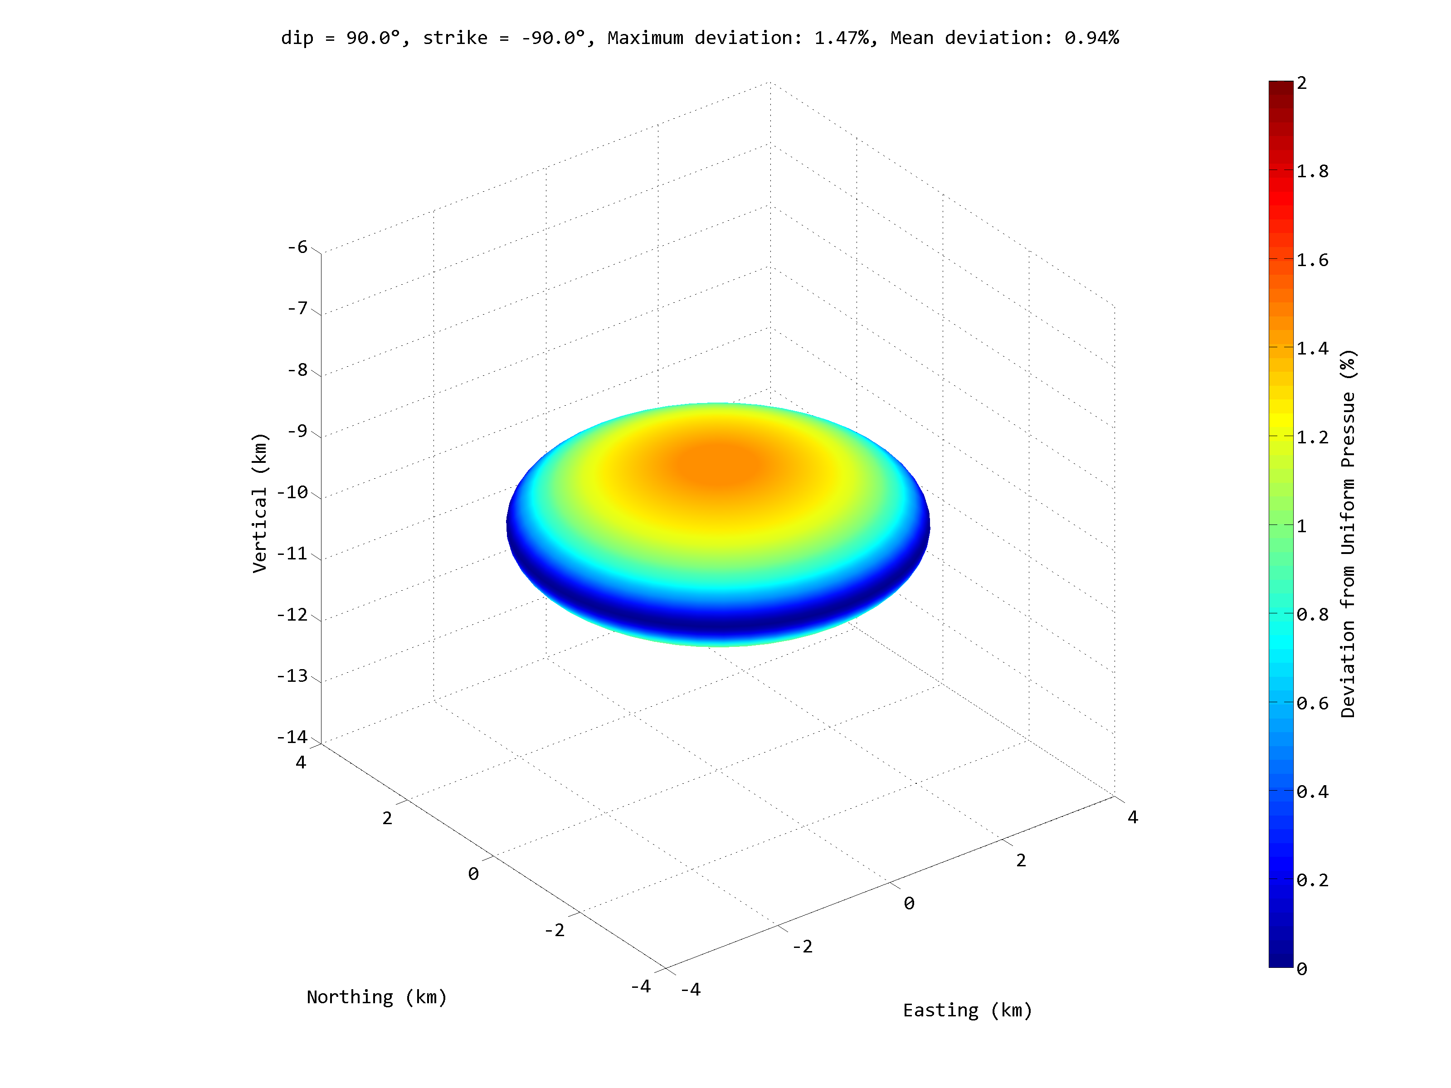
The Oblate Spheroid as a Goes to Zero
Spheroid Parameters
a = 1000 m
b = 3000 m
Depth = 10000 m
P/μ = 1

Slide 21
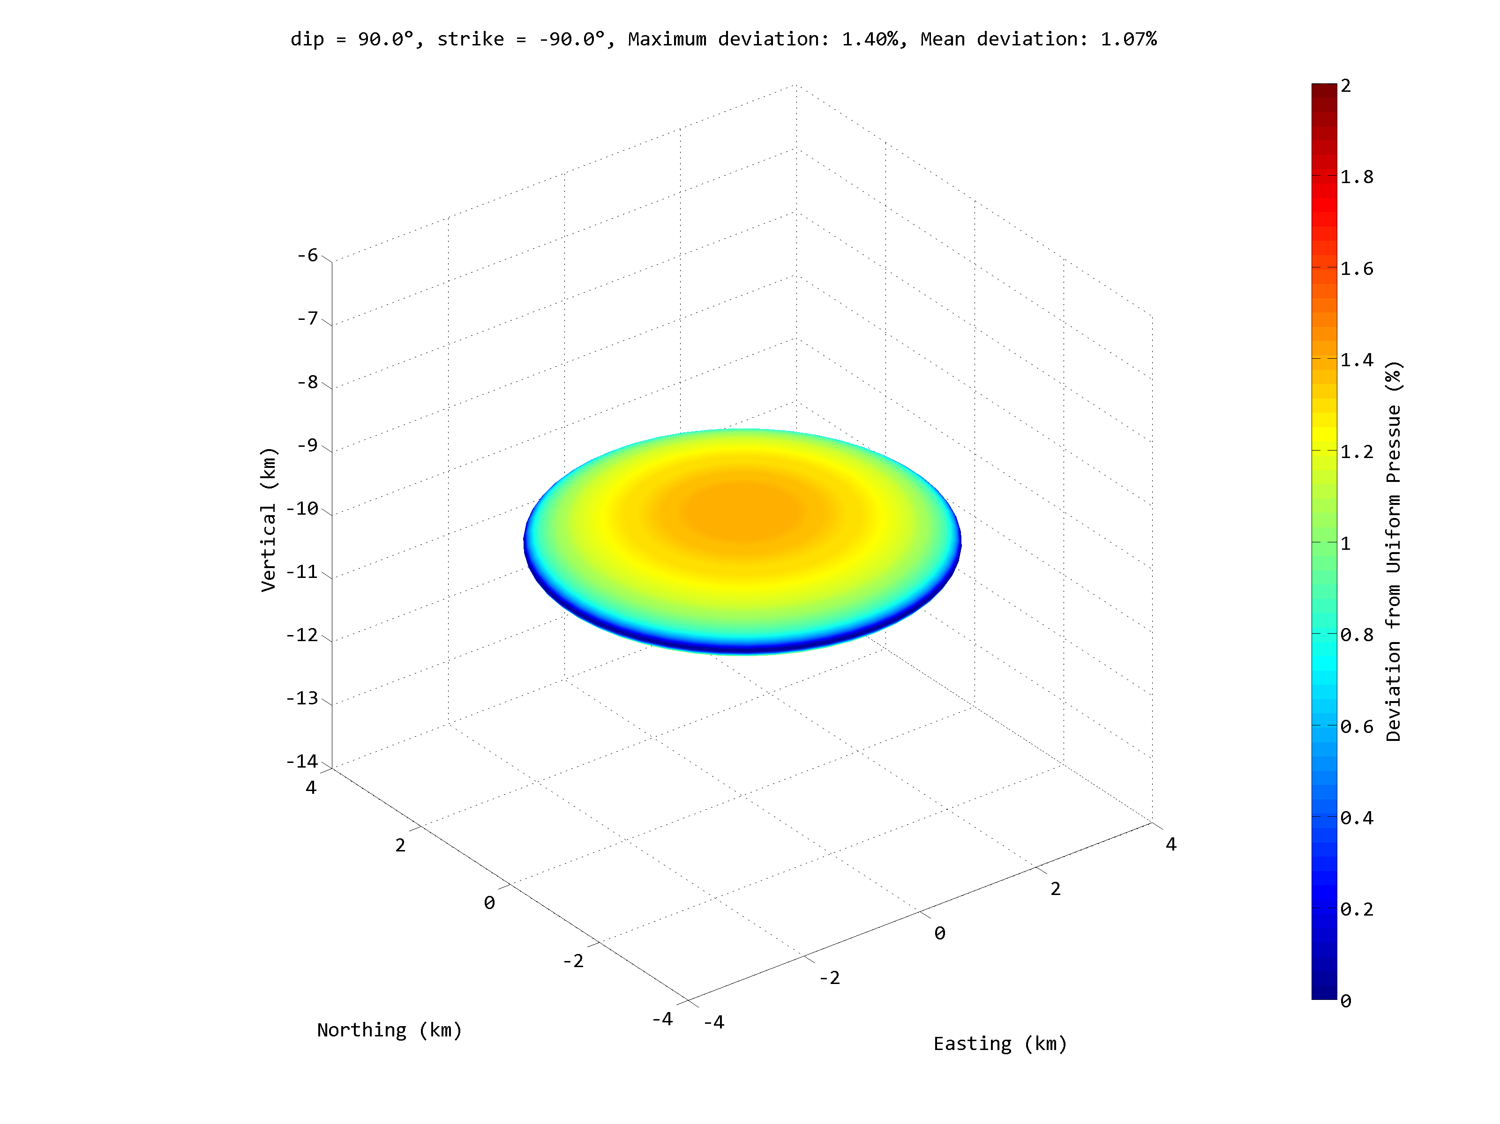
The Oblate Spheroid as a Goes to Zero
Spheroid Parameters
a = 500 m
b = 3000 m
Depth = 10000 m
P/μ = 1

Slide 22
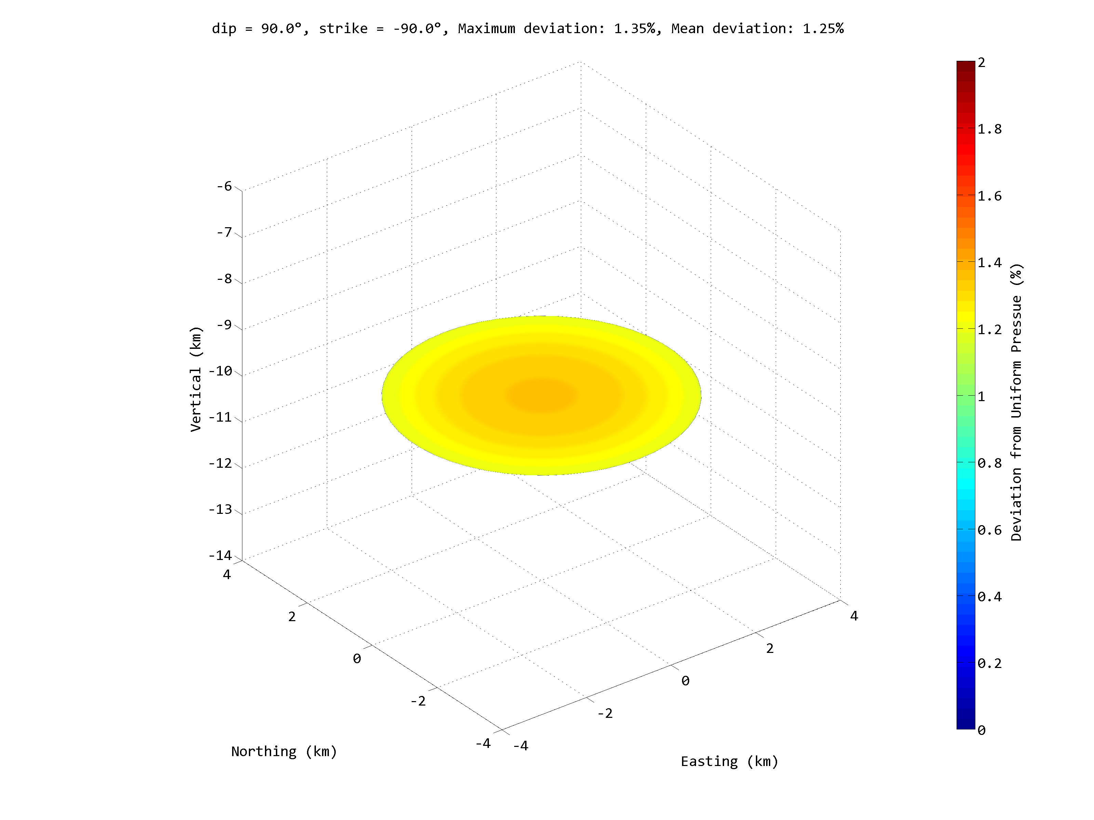
The Oblate Spheroid as a Goes to Zero
Spheroid Parameters
a = 0 m
b = 3000 m
Depth = 10000 m
P/μ = 1

Slide 23
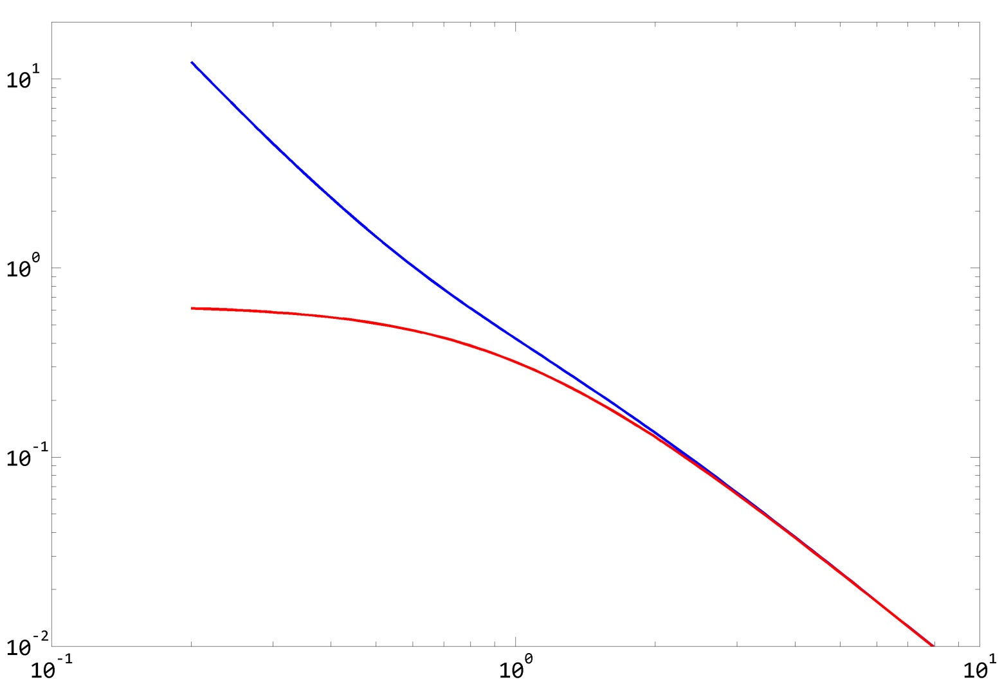
Comparison to Fialko’s Penny-shaped Crack
Fialko, et al. (2001)
Fialko’s solution is exact
Oblate spheroid
Normalized Vertical Displacement
Oblate spheroid is approximate
Depth / Radius (b)
Oblate spheroid with a = 0 equivalent to the solution of Sun, 1969

Slide 24
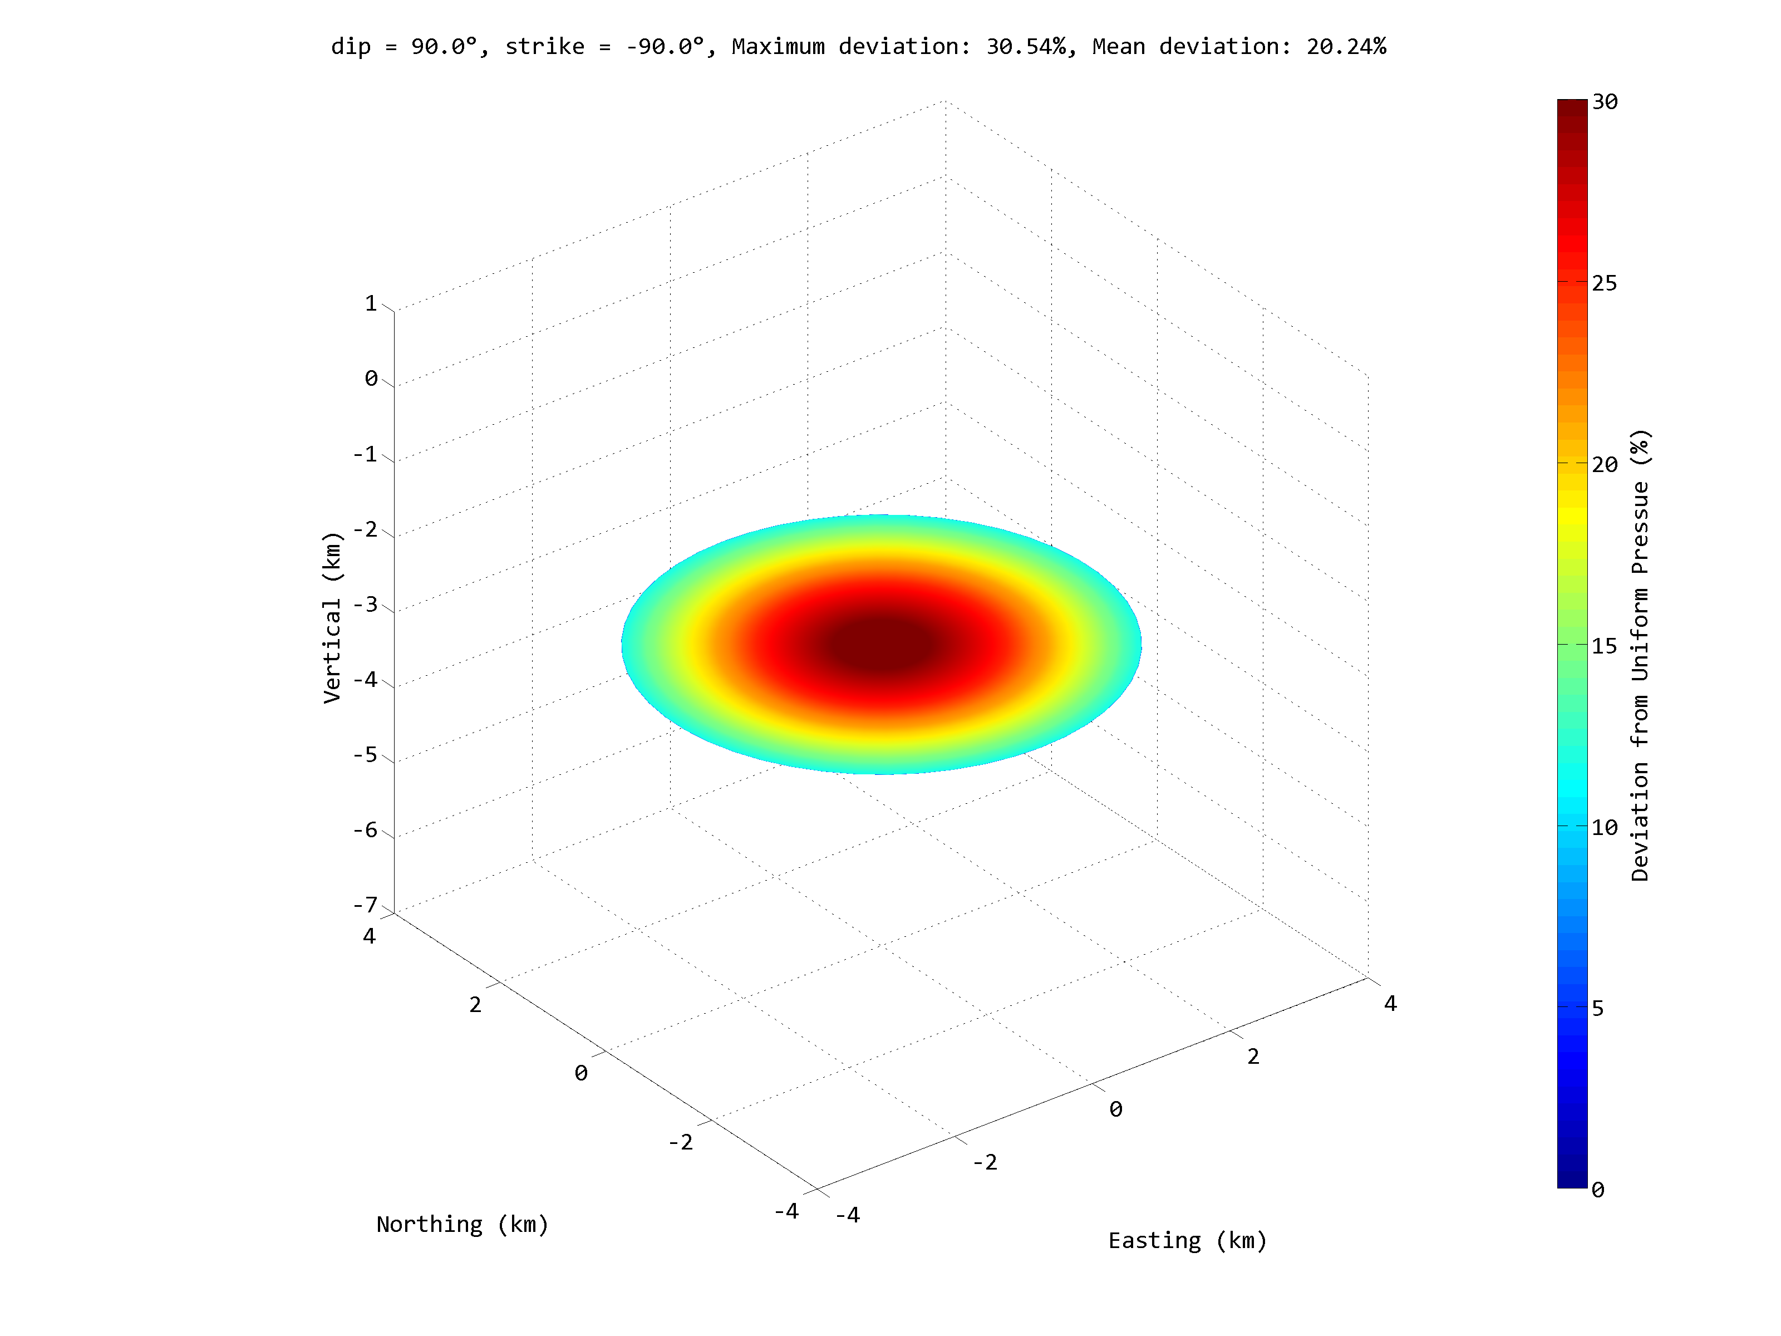
The Oblate Spheroid as a Goes to Zero
Spheroid Parameters
a = 0 m
b = 3000 m
Depth = 3000 m
P/μ = 1

Slide 25
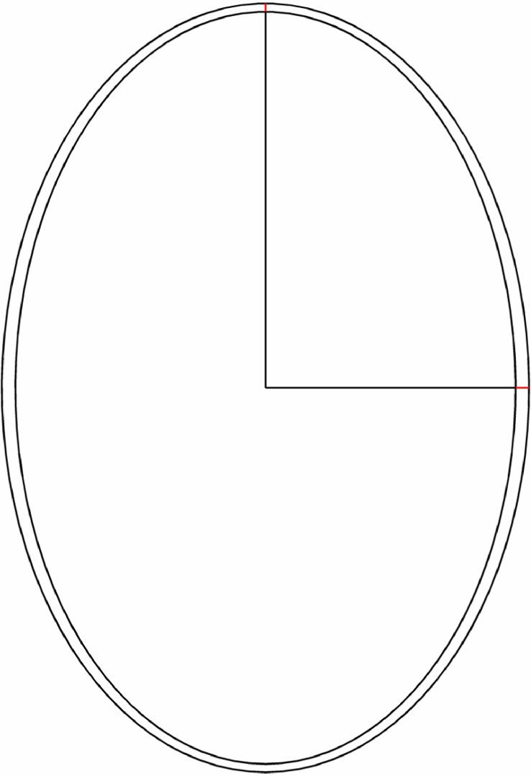
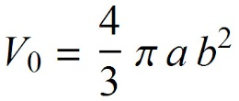
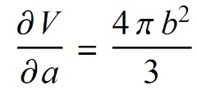
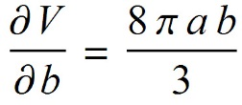
Pressure / Volume Relationship
Volume Prior to Pressurization:
δa
Volume After Pressurization:
a
Volume Change:
b
δb
Partial derivatives with respect to axes:
and
Approximate volume change:

Slide 26
Pressure / Volume Relationship
δa
Derive analytical expressions for δa and δb in a full space:
a
Insert into:
b
δb
Giving the key relationships:

Slide 27
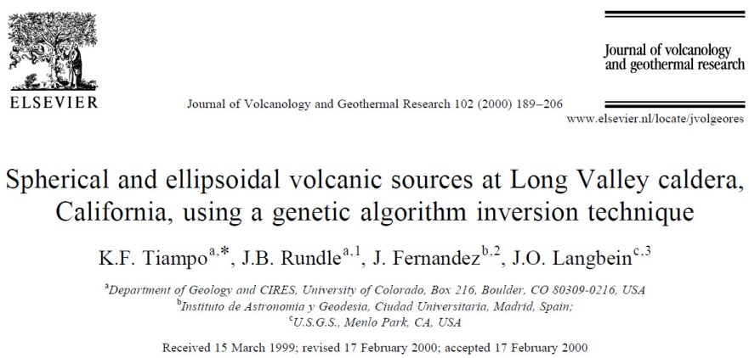
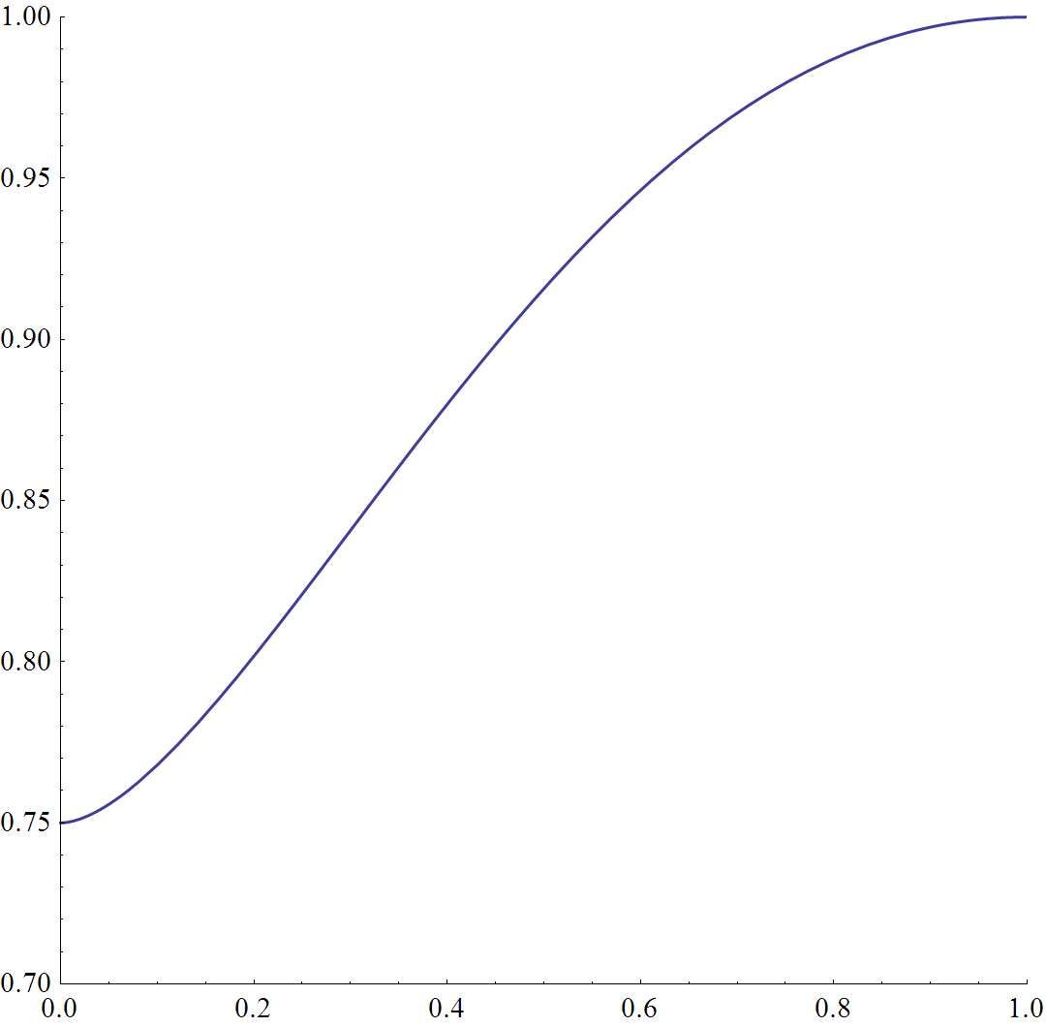
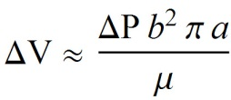
Comparison to Other Approximations
delta
Tiampo et al., 2000, derived an approximation of volume change presented there in equation 18:
Aspect Ratio (a/b)
Compared to:

Slide 28
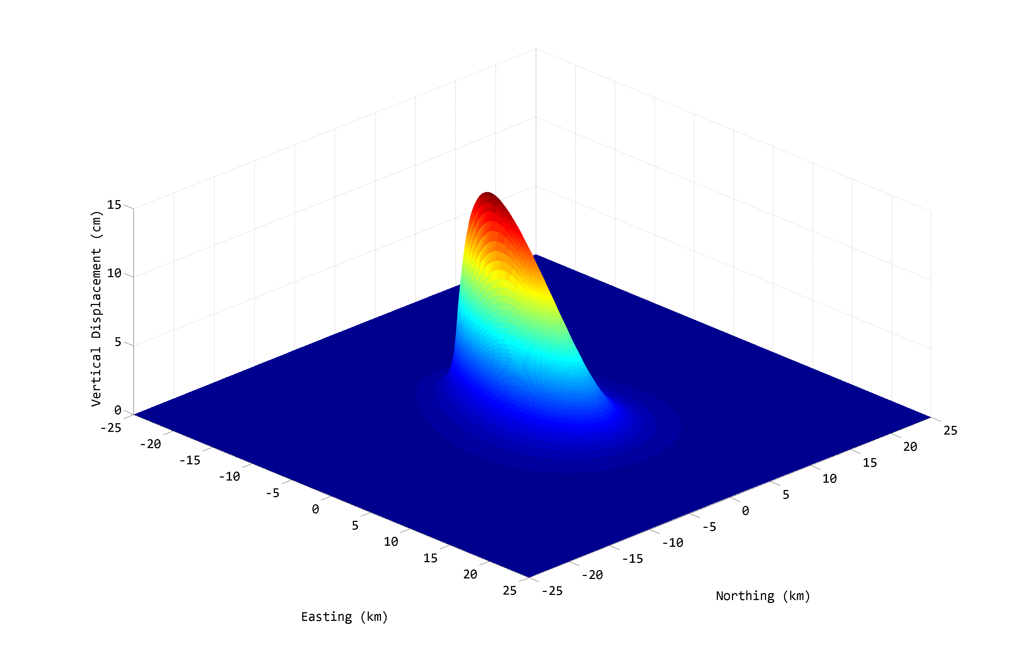
The End
Please visit:
volcanoes.usgs.gov/software/spheroid
for Matlab code and Mathematica notebooks

